Slide 1
Demonstration on uber database in new York(2014)
Presented by : -
Prabhsimar Singh[1603023] , Pushvinder Singh[1603033] , Harpreet Kaur[1602964]

Slide 2
BASed on K-Means Clustering
Clustering is an unsupervised learning technique. It is the task of grouping together a set of objects in a way that objects in the same cluster are more similar to each other than to objects in other clusters.
Clustering is mainly used for exploratory data mining. It is used in many fields such as machine learning, pattern recognition, image analysis, information retrieval, bio-informatics, data compression, and computer graphics.
We have worked on a case study to see the working of k-means on the Uber dataset using R. The dataset is freely available and contains raw data on Uber pickups with information such as the date, time of the trip along with the longitude-latitude information. We have applied clustering on this dataset to identify the different boroughs within New York.

Slide 3
In this section, we have worked with the Uber dataset, which contains data generated by Uber for the city on New York. Uber Technologies Inc. is a peer-to-peer ride sharing platform.
New York city has five boroughs: Brooklyn, Queens, Manhattan, Bronx, and Staten Island. At the end of this Project, we have applied k-means clustering on the dataset to explore the dataset better and identify the different boroughs within New York.
Here in the dataset is the column of Base which represents different base code given to the following customer who has booked a ride in Uber . Each uber pickup is affiliated with a TLC (Taxi and Limousine Commission) company base. The Base Codes are :

Slide 4
Base Code | Base Name
B02512 | Unter
B02598 | Hinter
B02617 | Weiter
B02682 | Schmecken
B02764 | Danach-NY

Slide 5
Problem statement
This data when mined over location can provide information about the major attractions of the city, it can help us understand the various zones of the city such as residential areas, office/school zones, highways, etc. This can help governments and other institutes plan the city better and enforce suitable rules and regulations accordingly. For example, a different speed limit in school and residential zone than compared to highway zones. The data when monitored over time can help us identify rush hours, holiday season, impact of weather, etc. This knowledge can be applied for better planning and traffic management. This tutorial will only concentrate on trying to solve the problem of identifying the five boroughs of New York city using k-means algorithm, so as to get a better understanding of the algorithms, all along learning to tackle a data science problem.

Slide 6
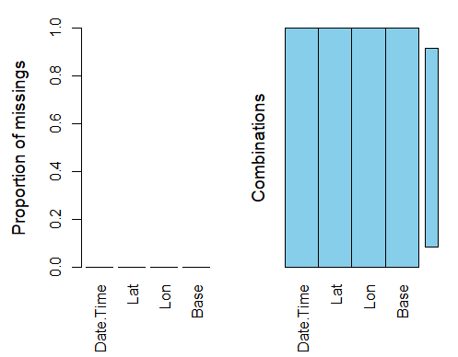

Slide 7
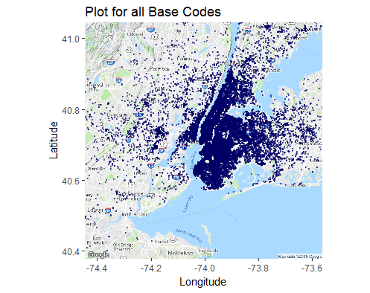

Slide 8
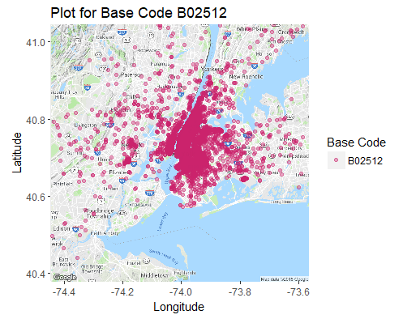

Slide 9
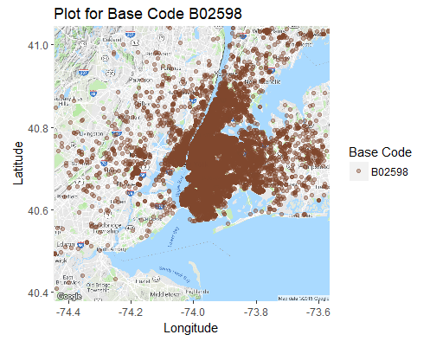

Slide 10
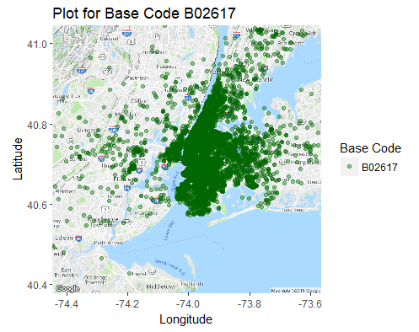

Slide 11
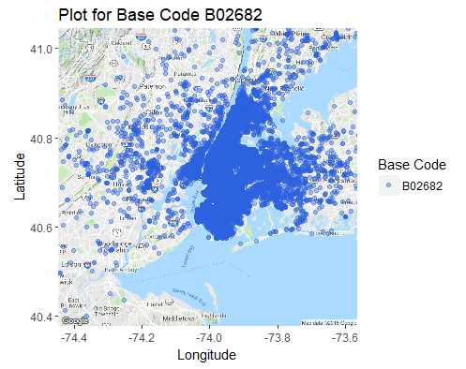

Slide 12
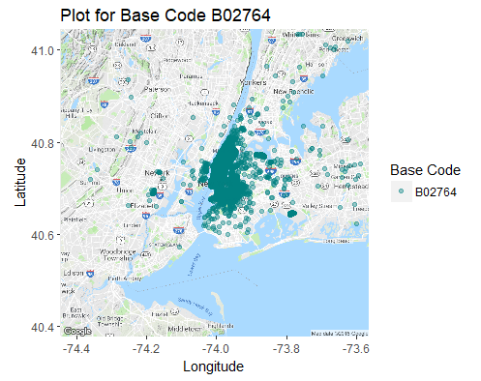

Slide 13
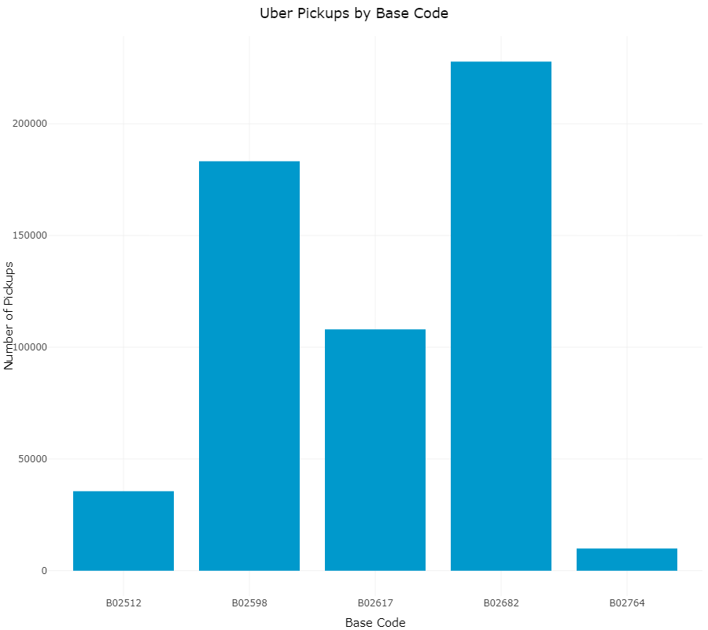

Slide 14
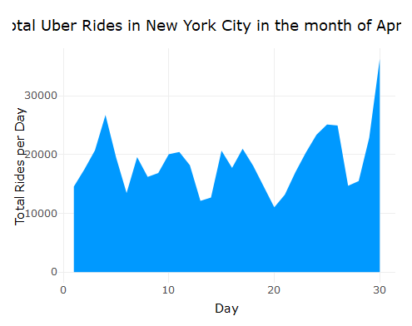

Slide 15
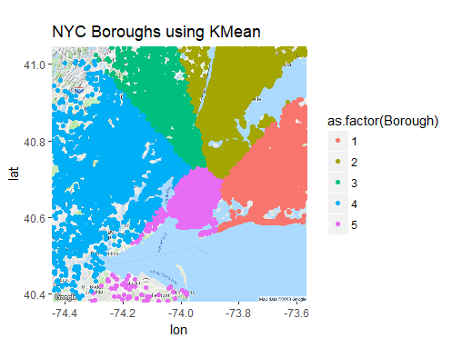

Slide 16
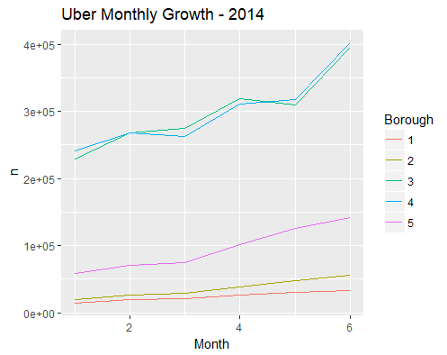

Slide 17
Thank You

